Slide 1
First Lesson
Expectations – lining up and entering the room
Equipment

Slide 2

Equipment
Avid Binder

Slide 3

Equipment
Avid Binder
Pencils

Slide 4
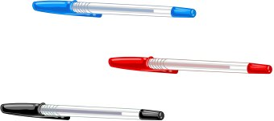
Equipment
Avid Binder
Pencils
Pens

Slide 5
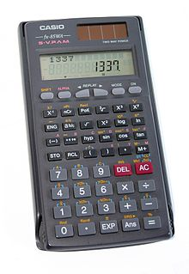
Equipment
Avid Binder
Pencils
Pens
Calculator

Slide 6
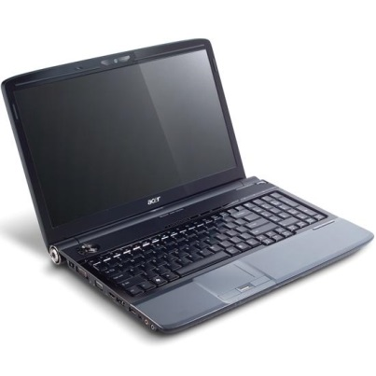

Equipment
Avid Binder
Pencils
Pens
PC or ipad
Calculator

Slide 7
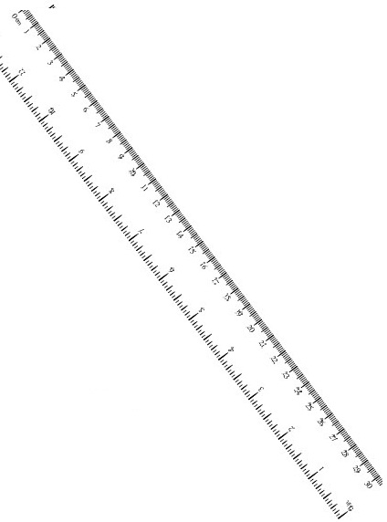
Equipment
Avid Binder
Pencils
Pens
PC or ipad
Ruler
Calculator

Slide 8
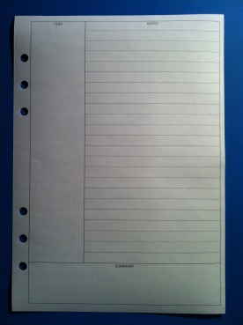
Equipment
Avid Binder
Pencils
Pens
PC or ipad
Ruler
Calculator
Interactive notebook

Slide 9

Equipment
Paper
Avid Binder
Pencils
Pens
PC or ipad
Ruler
Calculator
Interactive notebook

Slide 10
First Lesson
Expectations – lining up and entering the room
Equipment
BYOD
Connect

Slide 11
First Lesson
Expectations – lining up and entering the room
Equipment
BYOD
Connect
Expectations – Work and behaviour(Classroom rules to allow everyone to learn)
Homework

Slide 12









My Number Interactive Notebook
$$×$$
$$\frac{1}{2}$$
$$÷$$
$$+$$
$$−$$
$$\frac{3}{5}$$
$$7$$
Name
Class
Teacher
Term 1 Semester 1
$$5^{2}$$
$$\sqrt{9}$$
1

Slide 13
Create your own front page
It needs to contain the following –
My number interactive notebook
Your name
Class 9-6
Teachers Name – Mrs Rust
Semester 1 Term 1
Page number 1

Slide 14
Contents
Glossary or Formula Page
Page
Date
Description
2
3

Slide 15
Tasks
24
7
30
Essential Question
Questions
Notes
Summary
4
5

Slide 16
24
7
30
Date
Title
EQ –
5

Slide 17
Questions

Slide 18
Notes Review
24, 7 ,30
Date
Title
Essential question
Notes complete
Notes complete with colour and diagrams
Questions completed
Contents page filed in
Formula page filled in

Slide 19
Homework
Naplan Practice
Review your notes and write a summary answering the essential question.

